Slide 1
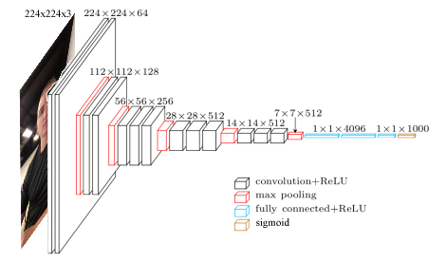
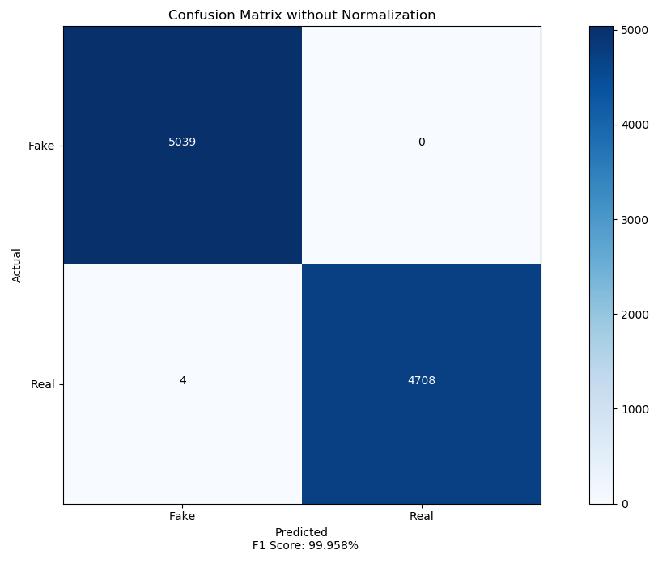
Im-Ception
Facial PAD Through Fine Tuning Deep Convolutional Neural Networks
Cooper Wakefield – Prof. Brian Lovell
INTRODUCTION
Presentation attack detection (PAD) encompasses the field of detecting the attempt to spoof a biometric reader. In the case of this thesis, it is that of facial recognition engines. In recent years, facial recognition has entered its way into the consumer market and thus the security of these devices has come to the forefront of people’s concerns. The purpose of this study is to investigate the plausibility of the use of deep learning in this protection.
PROBLEM
The inability to successfully prevent attacks on facial recognition engines negatively impact:
General Public: With consumer goods now using facial recognition to perform everything from unlocking to authorizing payment, a breach could mean unfettered access to an individual's personal details, passwords, and even banking.
Organisations: Facial recognition has been used in verification for entry into establishments or through layers of security for years. The threat remains the same for a breach of these systems, where access to areas not granted to an individual could have huge cost to the business.
OBJECTIVES
Phase 1 Was reserved for research and most importantly the dataset collection phase, whereby it proved to be the key to a successful project.
Phase 2 Was reserved for development of the solution. Where training each model took upwards of 20 hours. This was only training from layer 15 upwards. This highlights the decision to leverage transfer learning.
DESIGN
Dataset: 76000 training images split evenly over 2 categories (Real and Fake). 11000 validation images split evenly over the 2 categories. 9500 test images split over 2 categories. This is using a dataset that contained 7 individuals collected in differing lighting conditions with different clothing. Replayed on a laptop for generating the fake dataset.
Model: VGG16 leveraging fine tuning techniques to retrain it for the binary classification task of detecting whether a facial artefact is real or fake. The weights frozen up to the last convolution layer, with this last convolutional layer trainable as well as the fully connected layer.
SOLUTION & ANALYSIS
The proposed solution utilises transfer learning to fine tune the VGG16 deep convolutional neural network architecture to enable differentiation between real and fake facial artefacts. This was achieved through:
Replacing the fully connected layer: The fully connected layer is removed and replaced with a customized layer.
Using bottleneck features: The pre-trained architecture of VGG16 has been trained on an extremely large dataset (imagenet) and thus the lower levels of the network have learned general features. A key transfer learning concept is collecting bottleneck features. This is achieved by running the training and validation data over the convolutional layers once and storing the last activation mappings before the fully connected layer. This enables us to load these into a more efficient data structure to reduce computation.
Retraining: The higher levels of the convolutional layers and the fully connected layer are retrained to learn features specific to the classification task at hand. This is performed on the custom curated dataset made for this classification task and describes the process of updating the weights at each layer.
OUTCOMES
This was a proof of concept, whereby to develop a fool proof system would require:
An extremely large dataset.
Large computing power for training.
Extremely varied data both in facial artefacts, ethnicity, lighting, gender, modes of presentation attack and the devices used (if applicable).
The outcome of this thesis was extremely positive, with the model producing an F1 score of 99.96%. This proved that given extensive data under varied conditions, it is possible to develop a very effective facial PAD engine through fine tuning deep convolutional neural networks.

